Slide 1
Sound Synthesis Using MatLab
Michael Shemesh
Matt Cooper
Andrew Parks
COSI 177a-Introduction to Scientific
Computing
Professor Praveen Chaturvedi

Slide 2
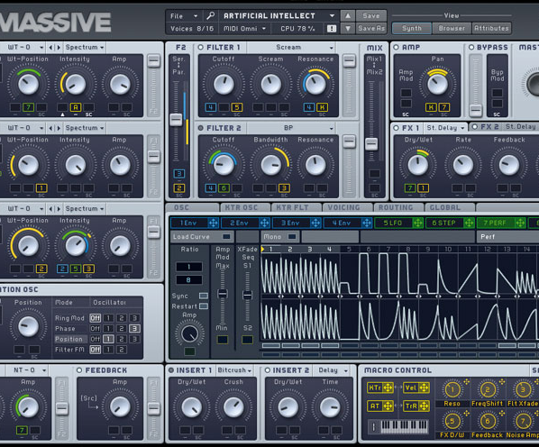
Goals
Generate audio and audio files using MatLab
Customize sound parameters
Create user-friendly interface
These skills can be applied to software development, creating products for musicians, audio engineers, and acousticians

Slide 3
Basics of Synthesis
Sound is the result of air vibrations at a specific frequency
We can represent a sound as an array of amplitude values, and use this array to play that sound through a speaker
The sound can be generated based on a frequency and waveform, such as sin, square, saw, and triangle
We can improve the quality of the sound by adding an Attack, Decay, Sustain, Release envelope
Matlab provides all of the tools necessary to create a fully functional sound synthesizer and more

Slide 4
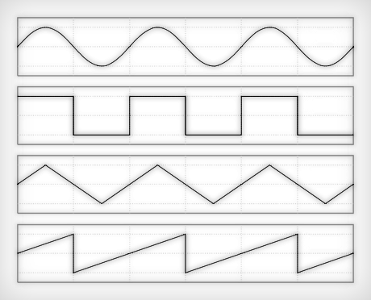
Waveform shapes
Each shape has a different sound
Sin waves are the most ‘natural’, containing all the harmonics of the base frequency
Square waves carry the most energy because they are always at peak amplitude, they contain only odd harmonics
Square waves are used to represent digital information, but can represent analog signals through pulse width modulation
Triangle waves also contain only odd harmonics
Sawtooth waves contain even and odd harmonics and are used as the basis for subtractive synthesis

Slide 5
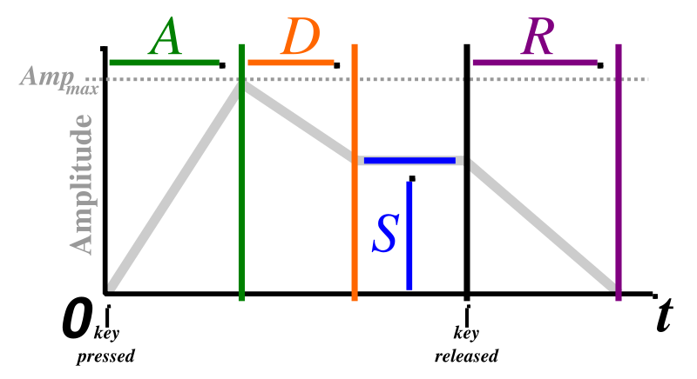
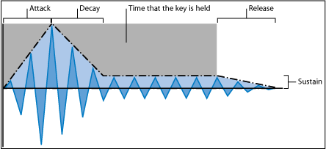
ADSR Envelope
In order to improve the quality of the waveform’s sound, we add an envelope to the amplitude
The envelope includes attack, decay, sustain, and release as parameters
Attack is the duration of the fade in from 0 to full volume
Decay is the decrease in volume from full to the sustain level
Sustain is the volume which the sound stays constant at
Release is the time of the fade out from sustain volume to 0

Slide 6
function [A] = ADSR(attack,decay,sustain,release,duration)
% This function has to create an envelope the length of the waveform
% which is shaped according to the adsr parameters.
% First make the array
% check that the params will fit in the waveform
totalmintime=attack+decay+release;
if totalmintime > duration
% if the attack, decay, and release together are longer than the wave,
% shrink them
attack=(attack/totalmintime)*duration;
decay=(decay/totalmintime)*duration;
release=(release/totalmintime)*duration;
end
%This part of the envelope goes from 0 to 1 over the attack time
attackArray = (0:(attack*44100))/(attack*44100);
%The decay part goes from 1 to sustain over the decay time
decayArray = ((decay*44100):-1:0)/(decay*44100)*(1-sustain)+sustain;
%The release array goes from sustain to 0 over the relase time
releaseArray = (((release*44100):-1:0)/(release*44100))*sustain;
%The sustain array is constant for the remaining time
sustainArray = ones(1,floor((duration-totalmintime)*44100))*sustain;
%Combine the arrays
A= [attackArray decayArray sustainArray releaseArray];
end

Slide 7
function [ Y ] = waveform(ADSR,shape,frequency, volume)
duration=length(ADSR)/44100;
X=0:1/44100:duration;
switch shape % shape is the type of wave
case 'sin'
Y=sin(2*pi*frequency*X)*volume; % here is where well add ADSR envelope by multiplying volume by the envelope
case 'square'
period=(1/frequency);
time=period*44100; % need to make array of ones and negative ones
s=0:1:time/2;
s0=s*0-1; % -1
s1=s*0+1; % 1
s=[s0 s1]; % combine the two halves
Y=repmat(s,1,floor(frequency*duration))*volume; % replicate this cycle
case 'saw'
period=(1/frequency);
time=floor(period*44100); % the time of 1 period
s=-time:1:time; % go from -1 to 1 over the time of 1 period
rise=s*(1/time);
Y=repmat(rise,1,floor(frequency*duration))*volume;
case 'triangle'
period=(1/frequency);
time=period*44100;
s=-(time/2):1:time/2;
rise=s*(1/time);
fall=rise*-1;
s=[rise fall];
Y=repmat(s,1,floor(frequency*duration))*volume;
otherwise
Y=zeros(1,length(X)); % silence
end
% Add the ADSR envelope by .* the two arrays
Y=Y(1:min(length(Y), length(ADSR))).*ADSR(1:min(length(ADSR), length(Y)));
end

Slide 8
Graphical User Interface Hierarchy
Handles
Constants, Variables
Objects
GUI element
Callback Function
Create Function
Properties
Tag
Value

Slide 9
Matlab’s built-in GUI editor: guide
% --- Executes on slider movement.
function attackslider_Callback(hObject, eventdata, handles)
% hObject handle to attackslider (see GCBO)
% eventdata reserved - to be defined in a future version of MATLAB
% handles structure with handles and user data (see GUIDATA)
handles.attack=get(hObject, 'Value');
% Hints: get(hObject,'Value') returns position of slider
% get(hObject,'Min') and get(hObject,'Max') to determine range of slider
set(handles.attackdisplay,'String',handles.attack)
guidata(hObject, handles);
% --- Executes during object creation, after setting all properties.
function attackslider_CreateFcn(hObject, eventdata, handles)
% hObject handle to attackslider (see GCBO)
% eventdata reserved - to be defined in a future version of MATLAB
% handles empty - handles not created until after all CreateFcns called
% Hint: slider controls usually have a light gray background.
if isequal(get(hObject,'BackgroundColor'), get(0,'defaultUicontrolBackgroundColor'))
set(hObject,'BackgroundColor',[.9 .9 .9]);
end

Slide 10
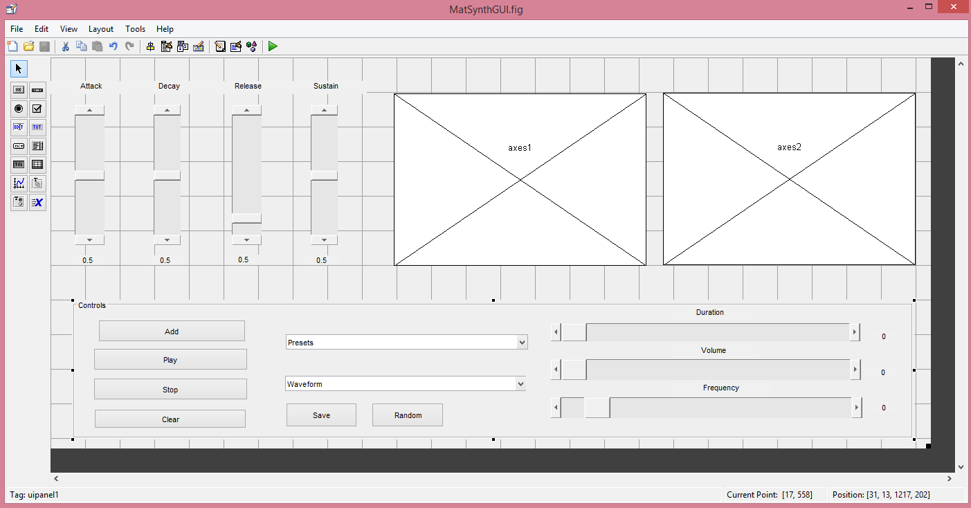

Slide 11
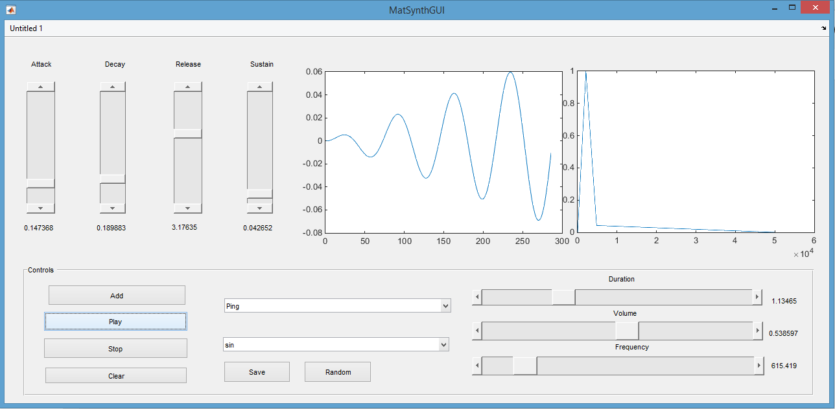

Slide 12
Future Additions
Midi support
Multilayered sounds
Curved envelopes
More presets
Stereo
Effects such as reverb and panning

Slide 13
Live demo!
Adjust parameters
Play sound
Pick preset
Randomize
Add to sequence
Save
Clear

Slide 14
References
Professor Praveen Chaturvedi

Slide 15
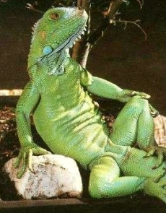
Stay nerdy, my friends.
The most interesting iguana in the world says code responsibly.

